Slide 1
Chapter 6
  An Introduction to System Software and Virtual Machines

Slide 2
Learning Objectives
Compare the virtual machine created for the user by system software with the naked machine
Describe the different types of system software
Explain the benefits of writing programs in assembly language rather than machine language
Describe how an assembler translates assembly language programs into machine instructions
List five key tasks of an operating system, and explain what each is and why it is critical to modern systems
Describe the different generations of operating systems, their features, and how each generation solved a drawback of the previous generation
对…至关重要
Notes:
将系统软件为用户创建的虚拟机与裸机进行比较
描述不同类型的系统软件
说明用汇编语言而不是机器语言编写程序的好处
描述汇编程序如何将汇编语言程序转换为机器指令
列出操作系统的五个关键任务，并解释每一项是什么以及为什么它对现代系统至关重要
描述操作系统的不同版本，其功能，以及每一代如何解决上一代的缺点

Slide 3
Introduction
A naked machine has no tools or programs to help the user:
  Write instructions in binary
  Write data in binary
  Load instructions into memory one cell at a time
  Initiate program run
Quickly became too difficult for humans to do
An interface had to be developed to hide the details and make the computer easier to build
Notes:
裸机没有工具或程序可以帮助用户：
用二进制写指令
用二进制写数据
一次将指令加载到内存中一个单元
启动程序运行
很快变得太难对人类去做
必须开发一个界面来隐藏细节并使计算机更易于构建

Slide 4
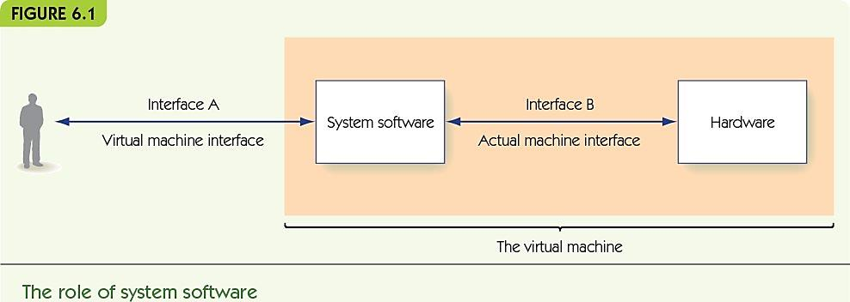
System Software (1 of 7)
System software is a collection of programs to:
  Manage resources of the computer
  Serve as intermediary between user and hardware
System software creates a virtual machine (or a virtual environment) that the user sees
Notes:
系统软件是用于以下目的的程序的集合：
管理计算机资源
充当用户和硬件之间的中介
系统软件创建用户可以看到的虚拟机（或虚拟环境）

Slide 5
System Software (2 of 7)
Operating system
single most important piece of software on the computer made up of:
  The user interface
  Memory managers
  I/O systems
  Utilities
  Language services
  Information managers
  Scheduler
用户界面
实用工具
语言服务
排程器
Notes:
操作系统
计算机上最重要的单个软件由以下组成：
用户界面
内存管理器
I / O系统
实用工具
语言服务
信息经理
排程器

Slide 6
System Software (3 of 7)
Communicates with users, determines what they want, and activates other system programs, applications, packages, or user programs
与用户沟通，确定他们想要什么，并激活其他系统程序，应用程序，程序包或用户程序

Slide 7
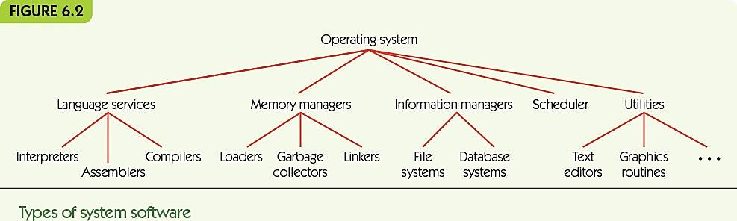
System Software (4 of 7)
Language services support high level languages
Memory managers allocate memory to programs
Information managers organize mass storage
Scheduler manages programs waiting to run
Utilities: tools, including program libraries
分配
Notes:
语言服务：支持高级语言
内存管理器：为程序分配内存
信息经理：组织海量存储
计划程序：管理等待运行的程序
实用程序：工具，包括程序库

Slide 8
System Software (5 of 7)
图形用户界面（GUI)
Graphical user interface (GUI): Pronounced “gooey”
Visual interface to the virtual machine including:
  Operating system and system programs
  User programs
I/O systems communicate with various devices such as:
  Printers
  Scanners
  Keyboards
  Mice
Notes:
图形用户界面（GUI）：发音为“ gooey”
虚拟机的可视界面包括：
操作系统和系统程序
用户程序
I / O系统与各种设备进行通信，例如：
打印机
扫描仪
键盘
鼠标

Slide 9
System Software (6 of 7)
Naked machine
Write program in binary
Load instructions one by one into memory
Insert start into memory address 0 and push “go” button
Read results from memory one by one, in binary
Notes:
裸机
1. 用二进制写程序
2. 将指令一 一载入内存
3.将开始插入到内存地址0，然后按“开始”按钮
4. 从存储器中以二进制方式一 一读取结果

Slide 10
System Software (7 of 7)
Virtual machine
Write program using text editor in high-level language
Save program to folder
Use translator to convert to binary
Use scheduler to load and run
Use I/O system to print results
Notes:
虚拟机
1. 使用高级语言的文本编辑器编写程序
2. 将程序保存到文件夹
3. 使用翻译器转换为二进制
4. 使用调度程序加载和运行
5. 使用I / O系统打印结果

Slide 11
Assemblers and Assembly Language (1 of 20)
Low-level programming language is also called assembly language:
Instructions map one-to-one to machine language
Symbolic op codes (not binary)
Symbolic addresses for instructions and data
Pseudo-ops for data generation and more (data in human-friendly terms)
Advantages over machine code
  Clarity, readability, and maintainability
  Can be placed at different locations in memory
Notes:
低级编程语言也称为汇编语言：
指令一对一映射到机器语言
符号操作码（非二进制）
指令和数据的符号地址
用于数据生成等的伪操作（以人类友好的术语表示的数据）
优于机器代码
清晰度，可读性和可维护性
可以放置在内存中的不同位置

Slide 12
Assemblers and Assembly Language (2 of 20)
High-level programming languages:
Java, C++, and Python
Advantages over assembly language:
  More powerful
    One high-level instruction may provide multiple machine instructions
  User oriented
  Not machine specific
  Use both natural language and mathematical notation
Notes:
高级编程语言：
Java，C ++和Python
优于汇编语言：
更有力
一条高级指令可以提供多条机器指令
面向用户
不是机器专用的
同时使用自然语言和数学符号

Slide 13
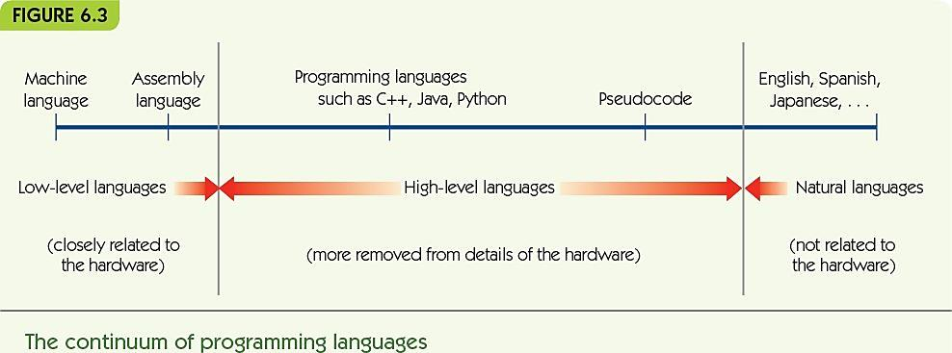
Assemblers and Assembly Language (3 of 20)

Slide 14
Assemblers and Assembly Language (4 of 20)
Assembly language process:
Source program (assembly language)
Translated by the assembler to
Object program (machine language)
Loader places in memory
Hardware runs
Results
Source code
Object code
Notes:
汇编语言过程：
源程序（汇编语言）
由汇编程序翻译为
目标程序（机器语言）
加载程序放置在内存中
硬件运行
结果

Slide 15
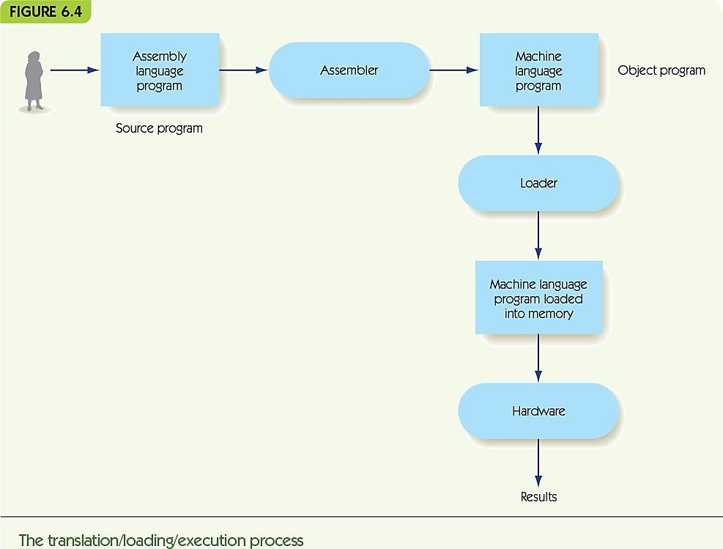
Assemblers and Assembly Language (5 of 20)

Slide 16
Assemblers and Assembly Language (6 of 20)
Example assembly language:
NEXTSTEP: LOAD X -- Put X into reg. R
label: opcode mnemonic address field -- comment
Label is optional name for this instruction’s location
Op code mnemonic and address field translate to machine language
Comments are ignored by assembler—just for human use
操作码助记符和地址字段转换为机器语言
Notes:
汇编语言示例：
下一个步骤：LOAD X-将X放入reg. R
标签：操作码助记符（一些操作的简写） 地址字段-注释
标签是此说明位置的可选名称
操作码助记符和地址字段转换为机器语言
汇编程序将忽略注释，仅供人类使用

Slide 17
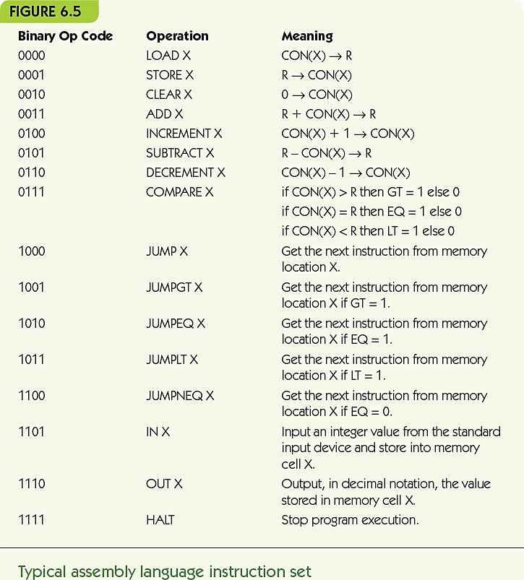
Assemblers and Assembly Language (7 of 20)

Slide 18
Assemblers and Assembly Language (8 of 20)
伪-op（伪指令）
Pseudo-op: commands in the program directed to the assembler, not converted to machine instructions:
  .BEGIN and .END to mark where instructions are
  .DATA to mark memory location as holding data:
    COUNTER: .DATA 0
    X: .DATA 12
Pseudo-op：程序中定向到汇编器的命令，未转换为机器指令：（assembler不会把这些转成machine language）
Notes:
Pseudo-op：程序中定向到汇编器的命令，未转换为机器指令：（assembler不会把这些转成machine language）
.BEGIN和.END标记指令的位置
.DATA将内存位置标记为保存数据：
计数器：.DATA 0
X：.DATA 12

Slide 19
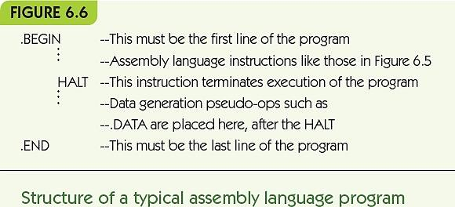
Assemblers and Assembly Language (9 of 20)

Slide 20
Assemblers and Assembly Language (10 of 20)
Simple examples:
x = y + 3
input a and b
while a > b do
print a
a = a – 2
LOAD Y
ADD THREE
STORE X
… -- Data comes after .END
X: .DATA 0 -- X is initially 0
Y: .DATA 5 – Y is initially 5
THREE: .DATA 3 –The constant 3
IN A
IN B
LOOP1: LOAD A A: .DATA 0
COMPARE B B: .DATA 0
JUMPLT LOOP1END TWO: .DATA 2
JUMPEQ LOOP1END
OUT A
LOAD A
SUBTRACT TWO
STORE A
JUMP LOOP1
LOOP1END: …

Slide 21
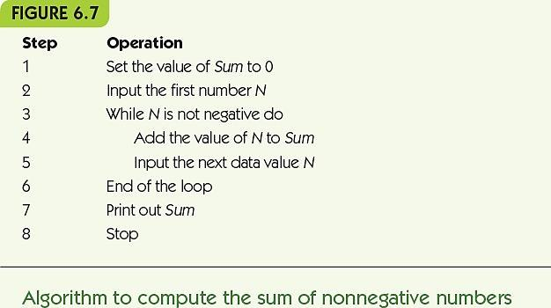
Assemblers and Assembly Language (11 of 20)

Slide 22
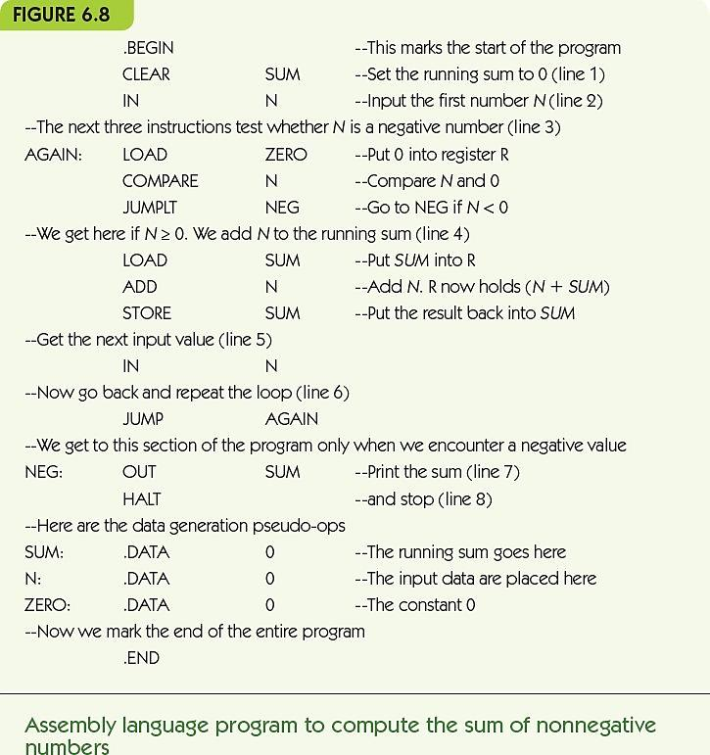
Assemblers and Assembly Language (12 of 20)

Slide 23
Assemblers and Assembly Language (13 of 20)
Translation and Loading
Assembler translates to machine language:
  Converts symbolic op codes to binary equivalents
  Converts symbolic labels to memory addresses
  Performs pseudo-op actions
  Writes object file containing machine instructions
Loader gets program ready to run:
  Places instructions in memory
  Triggers the hardware to run the program
（不转换为machine language）
触发
Notes:
翻译和加载
汇编程序：翻译成机器语言：
将符号操作码转换为等效的二进制代码
将符号标签转换为内存地址
执行伪操作
写入包含机器指令的目标文件
加载程序：使程序准备运行：
将指令放置在内存中
触发硬件以运行程序

Slide 24
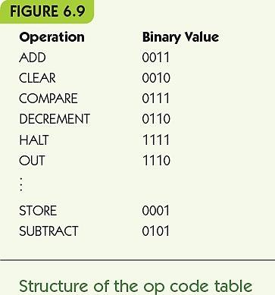
Assemblers and Assembly Language (14 of 20)
Converting symbolic op codes to binary ones
Assembler maintains a table
Assembler looks up
symbolic op codes in the
table and substitutes the
binary analogue
Use binary search to
optimize table lookups
Notes:
将符号操作码转换为二进制操作码
汇编器维护表
汇编器在表中查找符号操作码并替换二进制模拟量
使用二进制搜索来优化表查找

Slide 25
Assemblers and Assembly Language (15 of 20)
Converting symbolic labels to memory addresses
Assembler needs two passes
  Looks over assembly code two times
First pass:
  Keeps a count of how many instructions from the start
  Collects symbolic labels and add to symbol table along with location counter
将符号标签转换为内存地址
汇编器需要两次通过
两次查看汇编代码
从头算起有多少条指令
收集符号标签并与位置计数器一起添加到符号表中

Slide 26
The first pass
主要是build a symbol table
Symbol table is the all of the label name we used
记录label的名字和地址
每个label只能用一次

Slide 27
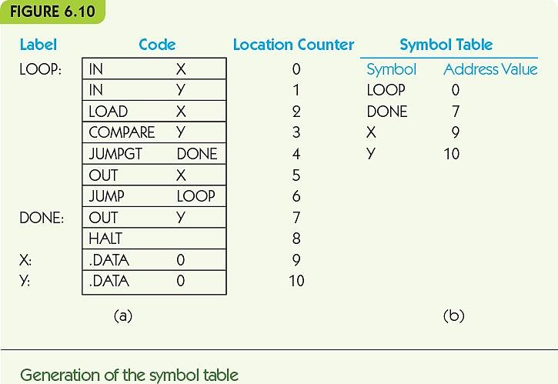
Assemblers and Assembly Language (16 of 20)

Slide 28
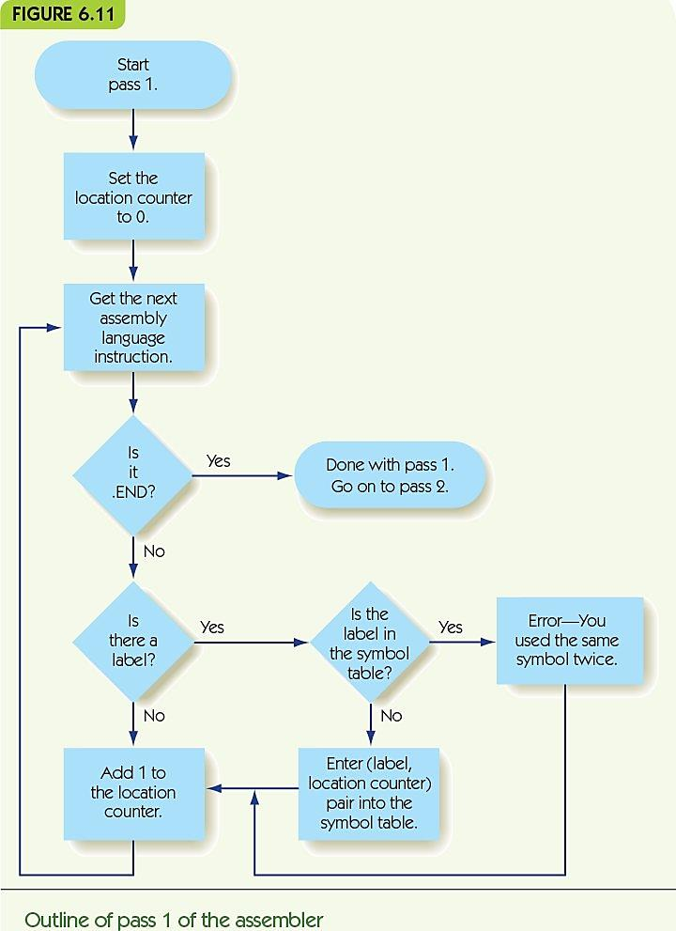
Assemblers and Assembly Language (17 of 20)

Slide 29
Assemblers and Assembly Language (18 of 20)
Second pass:
  Looks up and replace op codes
  Substitutes label references with location from symbol table
  Sets up .DATA pseudo-ops with location and binary value
  Writes instructions to object file
第二遍：
查找并替换操作码
用符号表中的位置替换标签引用
使用位置和二进制值设置.DATA伪操作
将指令写入目标文件

Slide 30
  Second pass：
  Use the symbol table
  Create an object file

Slide 31
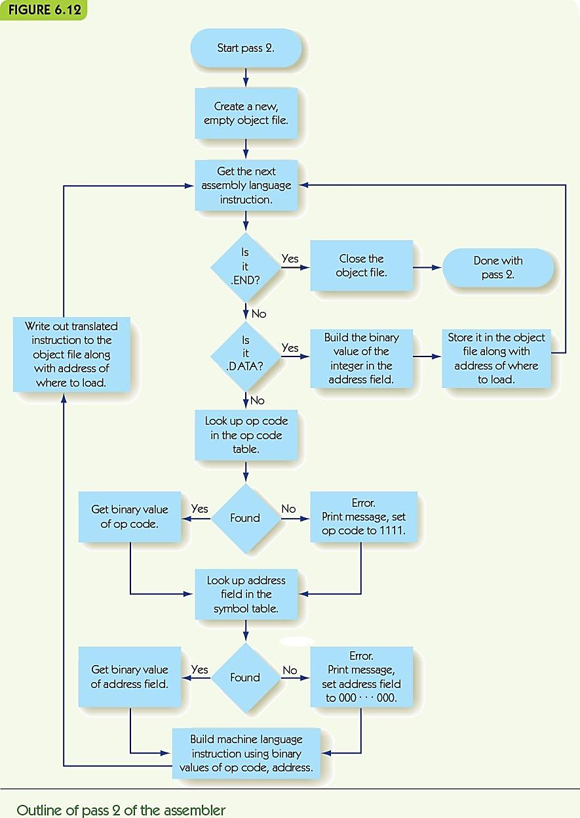
Assemblers and Assembly Language (19 of 20)

Slide 32
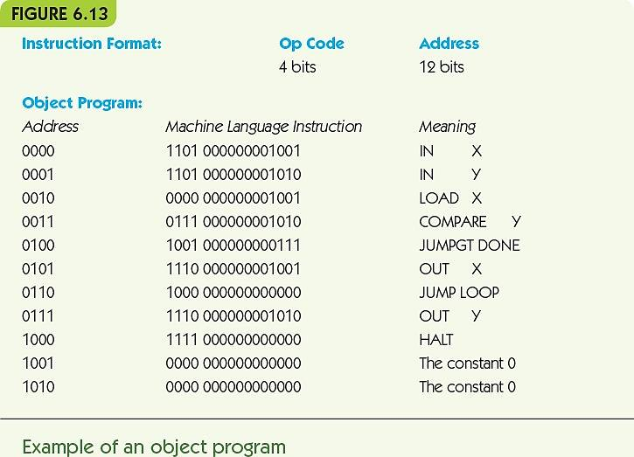
Assemblers and Assembly Language (20 of 20)

Slide 33
Operating Systems (1 of 21)
System commands: user instructions about what the computer should do
Some typical operating system commands
Load a program
Run a program
Save information in a file or a directory
Retrieve a file previously stored
List all the files for this user
Delete or rename a file
Print a file on a specified I/O device
Notes:
系统命令：有关计算机应该做什么的用户说明
一些典型的操作系统命令
载入程序
运行程序
将信息保存在文件或目录中
检索先前存储的文件
列出该用户的所有文件
删除或重命名文件
在指定的I / O设备上打印文件

Slide 34
Operating Systems (2 of 21)
Copy a file from one I/O device to another
Establish a network connection
Let the user set or change a password
Tell how much memory or data storage is being used
将文件从一个I / O设备复制到另一个
建立网络连接
让用户设置或更改密码
告诉正在使用多少内存或数据存储

Slide 35
Operating Systems (3 of 21)
Functions of an Operating System
User interface: user communicates with operating system
Operating system as receptionist and dispatcher
User command → system software scheduled and run → repeat
Text-based
  System commands typed at a prompt in a terminal
  Command language must be learned
GUI-based
  System commands by a visual/mouse interface
传达员
调度器
Notes:
操作系统功能
用户界面：用户与操作系统进行通信
操作系统作为传达员和调度员
用户命令→系统软件scheduled计划并运行→重复
基于文字
在终端提示符下键入的系统命令
必须学习命令语言
基于GUI
可视/鼠标界面的系统命令

Slide 36
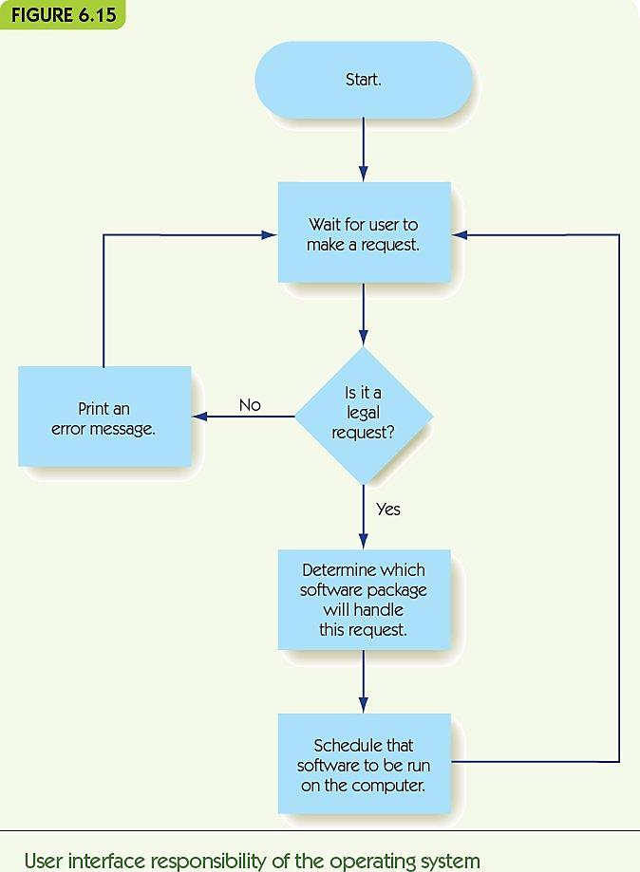
Operating Systems (4 of 21)

Slide 37
Operating Systems (5 of 21)
System security and protection: permit only authorized access to resources
Operating system as a security guard
Access protected by usernames and passwords:
  Superusers have more privileges
  Encrypt data to increase security
Folders and files have authorization lists:
  Read a file, add new information to a file, change existing information, and delete a file
Notes:
系统安全性和保护：仅允许授权访问资源
操作系统作为安全卫士
用户名和密码保护的访问：
超级用户拥有更多特权
加密数据以提高安全性
文件夹和文件具有授权列表：
读取文件，向文件添加新信息，更改现有信息以及删除文件

Slide 38
Operating Systems (6 of 21)
Access control list for the file GRADES
File: GRADES
Name | Permitted Operations
Smith | R(R=Read Only)
Jones | RA(A=Append)
Adams | RAC(C=Change)
Doe | RACD(D=Delete)

Slide 39
Operating Systems (7 of 21)
User interface management (receptionist)
Control of access to system and data files (security guard)
Program scheduling activation (dispatcher)
Efficient resource allocation (efficiency expert)
Deadlock and error detection (traffic officer)
Dispatcher(调度员):
你打电话给出租车公司叫车，接线员知道每个出租车的位置，会帮你安排车（接线员）相当于dispatcher
Notes:
用户界面管理（接待员/传达员）
控制对系统和数据文件的访问（安全防护）
程序调度激活（调度程序）
高效的资源分配（效率专家）
死锁和错误检测（交通官员）

Slide 40
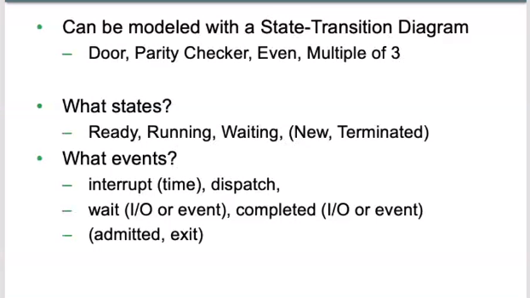
CPU scheduler
Interrupt: run go back to ready
Diapatch(发送): ready to run

Slide 41
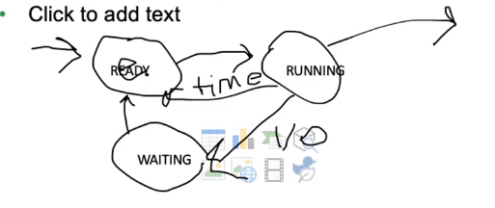
所有new process（新进度）start（new state）的时候goes into ready state 如果CPU现在没有任务，就会变成 Running State。run结束变成terminated
If it’s one if our process is start an I/O operator. It will go into a waiting mode(模式). 等I/O operator 知道它finish。 Finish之后再go back to wait in Ready State to go on the CPU again.。

Slide 42
Scheduler
State transition diagram

Slide 43
Operating Systems (8 of 21)
Example of sharing CPU:
Waiting Ready Running
B A
C
A makes I/O request:
Waiting Ready Running
A C B
A finishes with I/O:
Waiting Ready Running
C B
A

Slide 44
Operating Systems (9 of 21)
A deadlock occurs when multiple programs are requesting the resources that each one is currently using
Safe use of resources: ensure that the computer doesn’t get stuck in deadlock
Deadlock prevention:
if you can’t get all resources, release all you have and try again later
Deadlock recovery: if no acknowledgement, send message again
但这不是一直可能的
恢复
Notes:
当多个程序正在请求每个程序当前正在使用的资源时，将发生死锁
安全使用资源：确保计算机不会陷入僵局
防止死锁：如果无法获得所有资源，请释放所有资源，然后重试
死锁恢复：如果没有确认，请再次发送消息

Slide 45
Operating Systems (10 of 21)
Historical development of operating systems:
First generation: nearly “naked computer”:
  Programmer hand-loaded programs
Second generation: batch operating systems:
  Programmers gave programs to operators
  Operators collected a “batch” of programs
    Used I/O computer to translate programs to tape
    Ran programs as a group
    Used I/O computer to translate output to text/paper
  Job control language: instructions to OS
Notes:
操作系统的历史发展：
第一代：近乎“裸机”：
程序员手动加载的程序
第二代：批处理操作系统：
程序员向操作器提供程序
操作器收集了一批“程序”
使用I / O计算机将程序转换为磁带
小组运行程序
使用I / O计算机将输出转换为文本/纸张
作业控制语言：OS指令

Slide 46
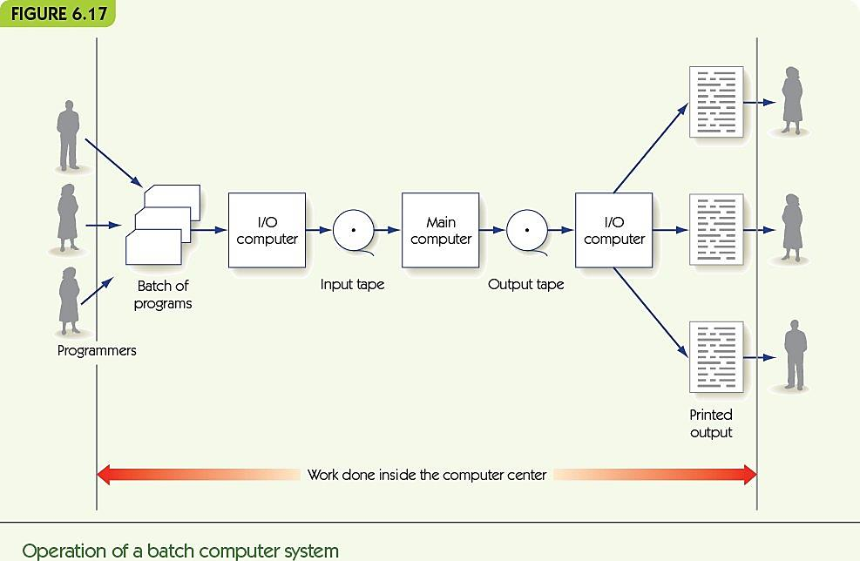
Operating Systems (11 of 21)

Slide 47
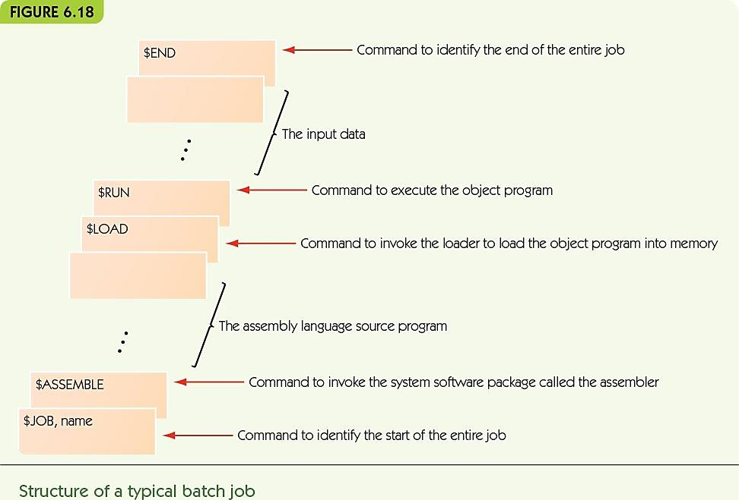
Operating Systems (12 of 21)

Slide 48
Operating Systems (13 of 21)
Third generation: multiprogrammed operating systems:
  Multiple programs loaded at once
  Switch between programs when I/O happens
  Computer security now required!
    Privileged operations only available to the administrator
    Bound memory a program can legitimately access
Notes:
第三代：多程序操作系统：
一次加载多个程序
发生I / O时在程序之间切换
现在需要计算机安全！
特权操作仅对管理员可用
程序可以合法访问的绑定内存

Slide 49
Operating Systems (14 of 21)
Time-sharing system (also third generation):
  Multiprogrammed, but users are on the system interactively
  Users need an illusion of sole access
  Allocate run time in time slices—each program runs until I/O OR time runs out
Notes:
分时系统（也是第三代）：
多程序，但用户以交互方式在系统上
用户需要唯一访问权的错觉
在时间片中分配运行时间-每个程序运行直到I / O 或者时间用完

Slide 50
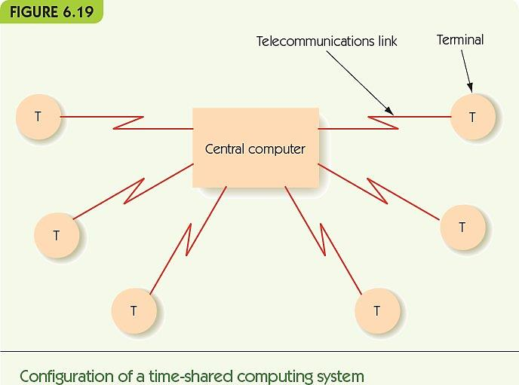
Operating Systems (15 of 21)

Slide 51
Operating Systems (16 of 21)
Fourth generation: network operating system:
  Operating system supports all the same local services
  Also supports services that access resources that are available over a network:
    Shared printer
    Servers: email, data, web
    Connections to the Internet
  Real-time operating systems or embedded systems are special-purpose computers in other equipment
Notes:
第四代：网络操作系统：
操作系统支持所有相同的本地服务
还支持访问网络上可用资源的服务：
共享打印机
服务器：电子邮件，数据，Web
互联网连接
实时操作系统或嵌入式系统是其他设备中的专用计算机

Slide 52
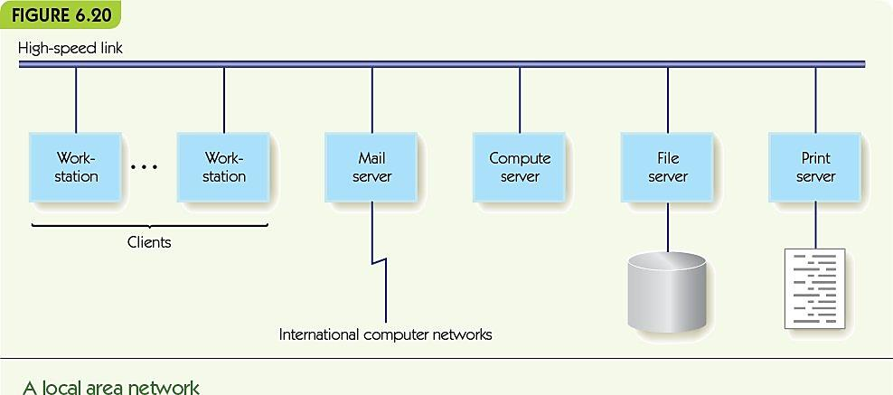
Operating Systems (17 of 21)

Slide 53
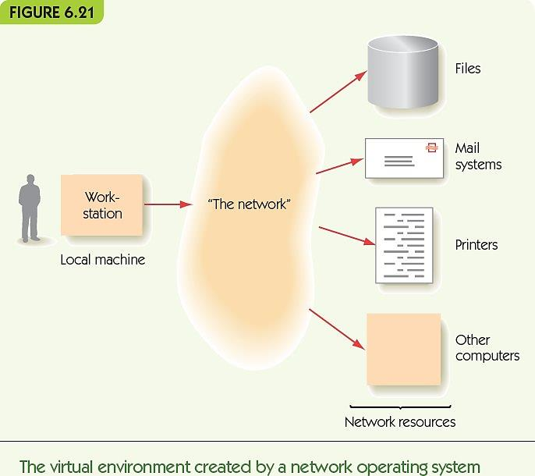
Operating Systems (18 of 21)

Slide 54
Operating Systems (19 of 21)
Fifth generation, the near future:
  Multimedia interfaces (integrate images, speech, and video seamlessly)
  Parallel processing system to perform multimedia and to permit larger scale tasks
  Distributed computing environment in which users don’t know where resources are stored
    Cloud computing
Notes:
第五代，不久的将来：
多媒体接口（无缝集成图像，语音和视频）
并行处理系统，用于执行多媒体并允许更大规模的任务
用户不知道资源存储在哪里的分布式计算环境
云计算

Slide 55
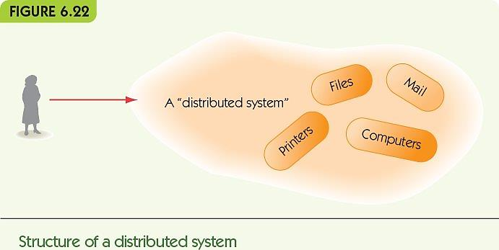
Operating Systems (20 of 21)

Slide 56
Operating Systems (21 of 21)
Some of the major advances in operating systems development
Generation | Approximate Dates | Major Advances
First | 1945-1955 | No operating system available Programmers operated the machine themselves
Second | 1955-1965 | Batch operating systems Improved system utilization Development of the first command language
Third | 1965-1985 | Multiprogrammed operating systems Time-sharing operating systems Increasing concern for protecting programs from damage by other programs Creation of privileged instructions and user instructions Interactive use of computers Increasing concern for security and access control First personal computer operating systems
Fourth | 1985-present | Network operating systems Client-server computing Remote access to resources Graphical user interfaces Real-time operating systems Embedded systems
Fifth | ?? | Multimedia user interfaces Massively parallel operating systems Distributed computing environments

Slide 57
Summary (1 of 2)
System software creates a virtual environment that is easy for users to use.
Assemblers and loaders are system software: translate human-friendly programs to machine language.
Assembly language uses symbolic names, symbolic op codes, and pseudo-ops to describe algorithms.
Assembler translates source programs to object files; loader places object instructions in memory.
Notes:
系统软件创建了一个易于用户使用的虚拟环境。
汇编程序和装载程序是系统软件：将人类友好的程序转换为机器语言。
汇编语言使用符号名称，符号操作码和伪操作来描述算法。
汇编程序将源程序转换为目标文件； 加载程序将对象指令放置在内存中。

Slide 58
Summary (2 of 2)
Operating systems communicate with users through text or GUI actions
The operating system includes key tasks such as the user interface, system security, scheduling of programs, and system safety
Operating systems developed through four generations of improvements, each adding new features and improving efficiency
Future operating systems: parallel, distributed, and multimedia, with resources stored remotely
Notes:
操作系统通过文本或GUI操作与用户通信
操作系统包括关键任务，例如用户界面，系统安全性，程序调度和系统安全性
通过四代改进而开发的操作系统，每一代都增加了新功能并提高了效率
未来的操作系统：并行，分布式和多媒体，资源远程存储

Slide 59
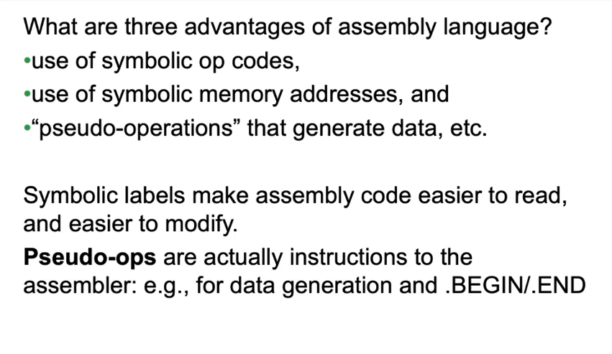
Quickly review

Slide 60
Quick review
What are the key task of an assembler?
  Translating op codes,
  Translating symbolic addresses,
  Performing pseudo-op tasks, and
  Creating an object file

Slide 61
Quick review
  How does an assembler use the symbol table?
  In the first pass(build a symbol table)
  ----collect the symbolic labels and their position relative to the start of the program
  In the second pass
  ----Replace(substitute) the position of the symbol(Replace the label with value)

Slide 62
Quick review
  What does it mean to bind(组合；结合) a symbolic name with a memory address? （in the symbol table）
Associating the name with the address
将名称与地址关联

Slide 63
Quick review
  What’s the purpose of the loader?
  to place the machine language program into memory
  send it to the hardware

Slide 64
Quick review
  A program written in assembly language is called a source progeam.
  The output of assembler be
  It called object program

Slide 65
True or False?
Pseudo-ops are instructions for services provided by the assembler.
伪操作是汇编程序提供的服务说明。
True

Slide 66
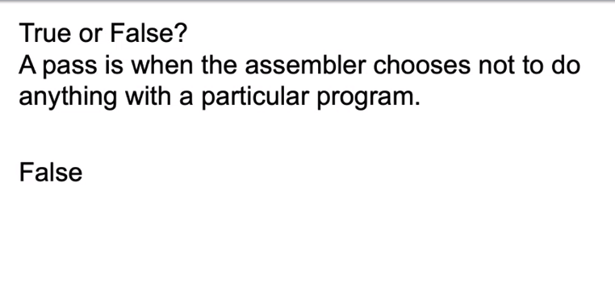

Slide 67
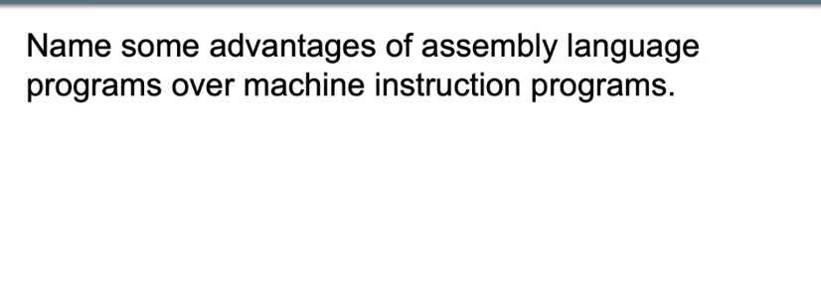
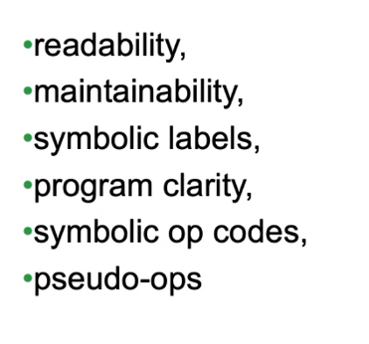

Slide 68
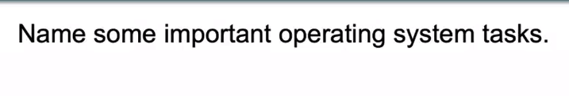
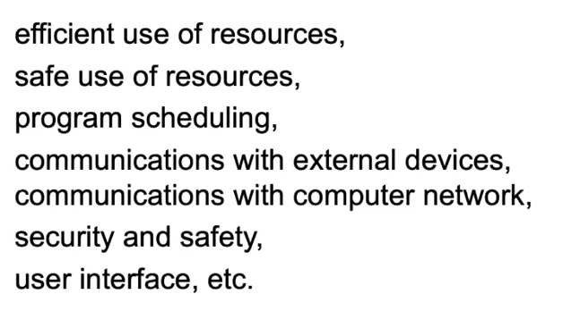

Slide 69
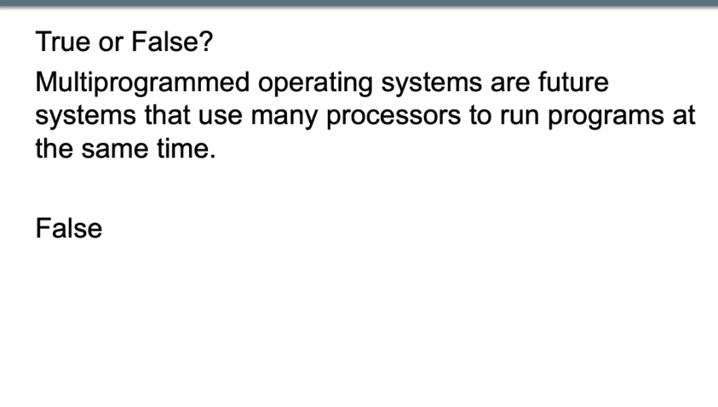

Slide 70
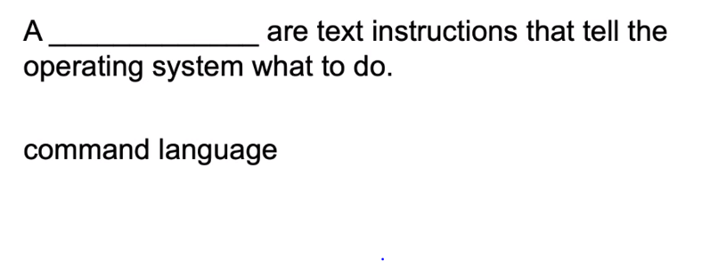
文字说明

Slide 71
